Slide 1

Forecast of Nuclear Power Generation until 2100
Asko Vuorinen
Ekoenergo Oy
Based on the Book: ”Planning of Nuclear Power Systems to Save the Planet”

Slide 2
Population Stabilization at 9 billion
Biggest growth
in Africa and India
No growth in the industrial world

Slide 3
Electricity consumption will rise from 20 to 50 PWh in 2100
Biggest growth
in China
Moderate growth
in North America
and Europe

Slide 4
25 PWh saving from the trend
Year 2100
-----------------------
Trend 75 PWh
Forecast 50 PWh
-----------------------Saving 25 PWh

Slide 5
Specific electricity consumption will rise from 3000 to 5600 kWh/c

Slide 6
Generation planning goals
To limit global warming to 2 degC
To limit cumulative CO2-emissions of energy industries to 2500 Gt
To limit cumulative CO2-emissions of electricity generation to 820 Gt (34 %)
  0) 2009:1500 kg/capita (500 g/kWh)
  1) 2050: 690 kg/capita (150 g/kWh)
  2) 2100:140 kg/capita (25 g/kWh)

Slide 7
Priorities in generation planning
1) Renewables (hydro, wind, bio, solar)
2) Combined heat and power (CHP)
3) Nuclear plants, if needed
4) Gas and oil plants, if needed
5) Coal plants, if needed

Slide 8
Hydro electricity generation increase from 3 to 6.5 PWh
Largest growth
in China
and Africa

Slide 9
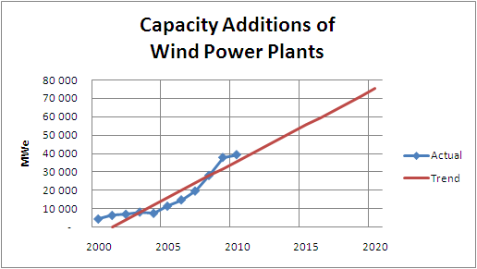
Capacity Additions of Wind Power Plants were 40 GWe
Source: BP 2011

Slide 10
Wind / wave capacity additions from 40 to 160 GWe/a

Slide 11
Wind and wave generation increase from 0.3 to 12 PWh

Slide 12
Biomass electricity generation increase from 0.2 to 1.6 PWh

Slide 13
Solar electricity generation achieve 9 PWh by 2100

Slide 14
CHP electricity generation increase from 2 to 6 PWh

Slide 15
Other generation will increase from 14 to 24 PWh by 2050

Slide 16
Nuclear Electricity Generation

Slide 17
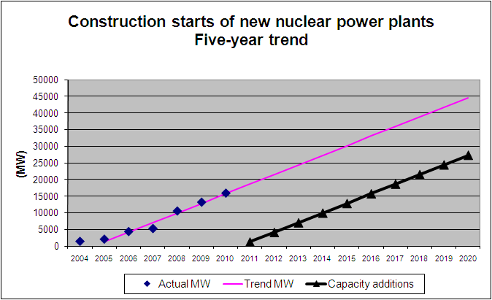
Construction starts of nuclear plants reached 15 GWe in 2010
Source: IAEA PRIS

Slide 18
Capacity additions of nuclear plants should increase to 65 GW

Slide 19
Nuclear electricity generation will peak at 19 PWh at 2080

Slide 20
Elecricity of LWR* power plants peak at 13 PWh in 2080
*Light Water Reactor (LWR)

Slide 21
Uranium demand will reach 16 million tons* by 2100
* $130/kgU resources 16 Mt by IAEA

Slide 22
Electricity generation by breeders will reach 6 PWh

Slide 23
Breeders
Types of breeders
  Plutonium-239
  Thorium-233
Break-even
  Uranium price from 130 to $260/kgU
  Breeder plant costs + €175/kWe
Beloyarsk breeders
  VVER-1000+40 %=+€1000/kWe

Slide 24
Fossil Fired Power Plants

Slide 25
Fossil electricity generation peak at 15 PWh in 2021

Slide 26
Oil and gas electricity generation will peak at 9 PWh in 2040

Slide 27
Orders of gas turbines and internal combustion engines
Source: Diesel & Gas Turbine Worldwide

Slide 28
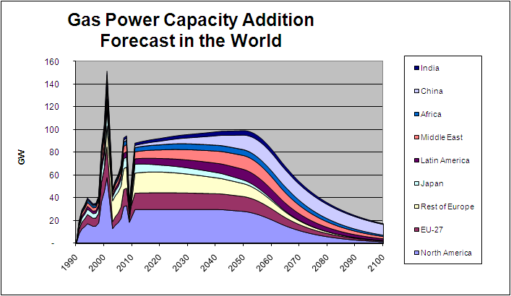
Gas power capacity addition forecast peak at 100 GWe/a

Slide 29
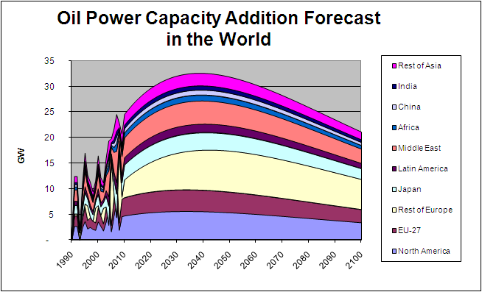
Oil power capacity additions will peak at 30 GWe/a (2020-2050)

Slide 30
Coal fired electicity generation will peak at 8 PWh in 2018

Slide 31
CO2-emissions and change in global temperature

Slide 32
CO2-emissions of electricity generation peak at 13 Gt in 2020

Slide 33
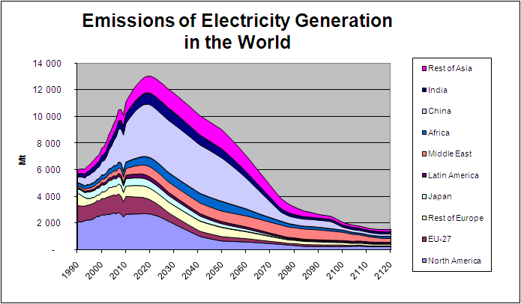
CO2-emissions of electricity by countries

Slide 34
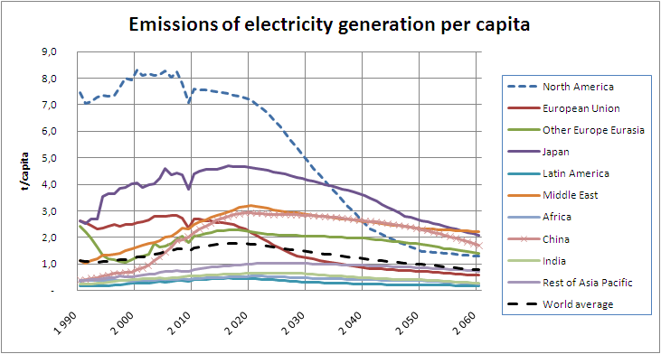
CO2-emissions of electricity per capita reach1t/capita by 2050*
* Carbon capture and storage needed in NA, China, Middle East, EE

Slide 35
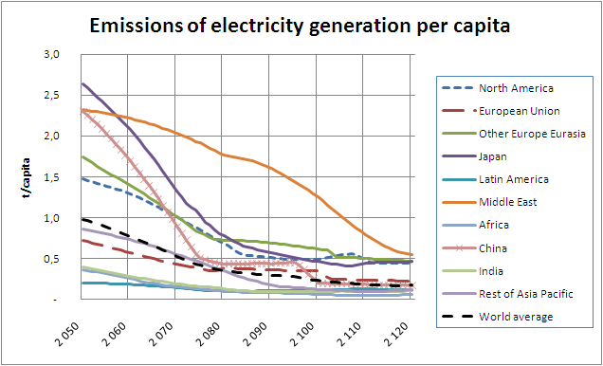
CO2-emission of electricity per capita reach 0.2 t/capita in 2100*
* Also carbon capture and storage (CCS) is needed in some areas

Slide 36
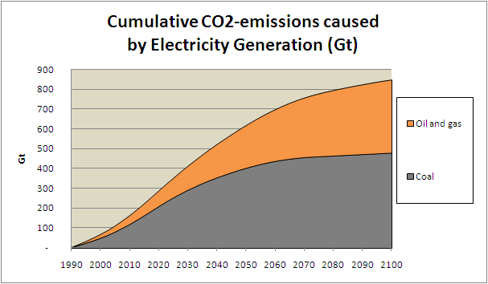
Cumulative CO2-emissions of electricity reach 850 Gt

Slide 37
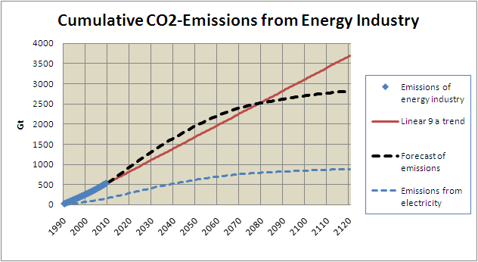
Cumulative CO2-emissions of energy industry reach 2800 Mt

Slide 38
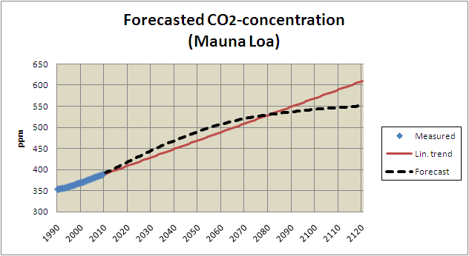
CO2-concentration at Mauna Loa will reach 550 ppm

Slide 39
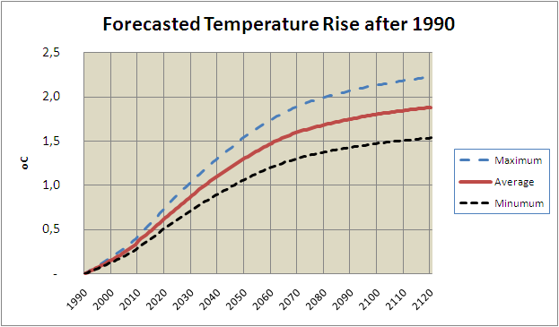
Global temperature increase from 1990 to 2100 will be < 2 C*
* Maximum figures assuming 100 % is anthropogenic

Slide 40
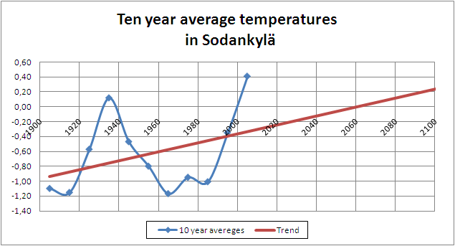
Actual increase in temperature in North Finland is about 0.6 degC

Slide 41
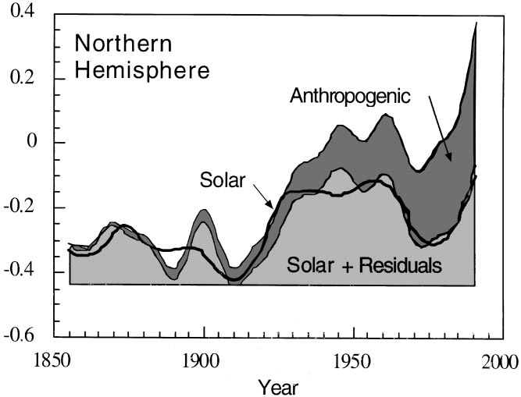
Anthropogenic influence 0.4 C
Solar influence 0.2 C*
* Source: Berger et al.

Slide 42
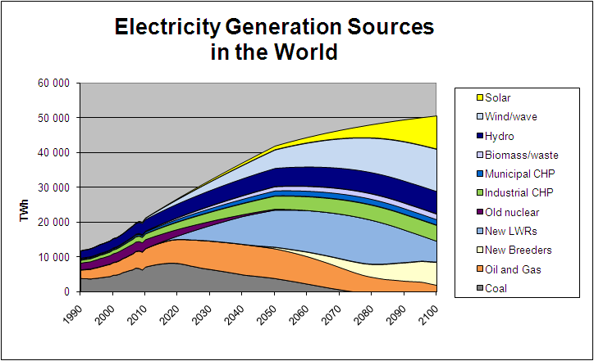
Forecasted electricity generation sources in the world

Slide 43
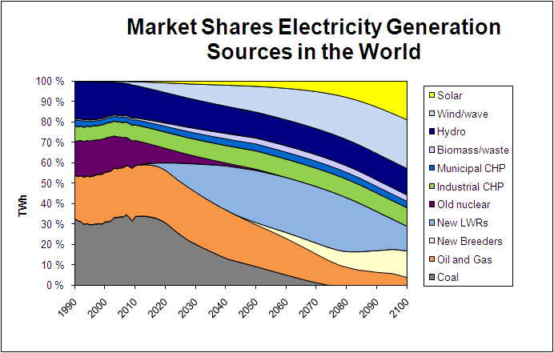
Market shares of electricity generation sources

Slide 44
Electricity ages (The highest market share of generation)
Coal age ->2020
Hydrocarbon age 2021-2040
Nuclear age 2041-2110
Wind and wave age 2111-2140
Solar age 2141-

Slide 45
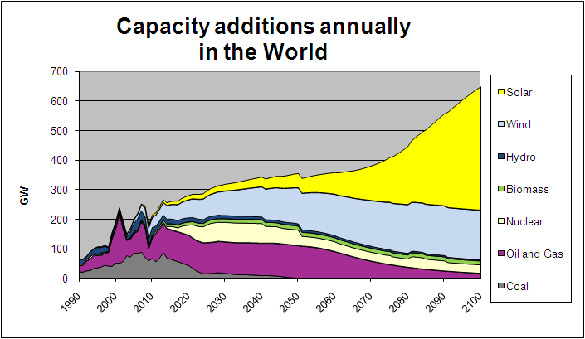
Capacity additions increase from 200 GWe to 300 GWe/a by 2030

Slide 46
Market leaders in capacity additions world wide
Oil and gas 1990-2040
Wind and wave 2040-2070
Solar 2070->

Slide 47
Summary
It is possible
  to limit global warming to 2 degC
  by limiting CO2-concentration to 550 ppm
How?
  Nuclear should be largest source of electricity in the world 2041-2110
  New nuclear plants needed (nuclear CHP and breeder)
  Also renewables, CHP, CCS and CO2-trading needed

Slide 48
Reference
Book:
”Planning of Nuclear Power Systems to Save the Planet”
Author: Asko Vuorinen
Publisher: Ekoenergo Oy
Date: August 2011
Soft cover ,176x250 mm, 304 pages, 149 figures, 100 tables
Price: €20 + sending costs
Orders:
www.optimalpowersystems.com
Contacts:
askovuorinen@gmail.com

